Slide 1

Vel Tech Rangarajan Dr. Sagunthala R&D Institute of Science and Technology
School of Computing
Department of Computer Science and Engineering
10211CS224 / FULL STACK APPLICATION DEVELOPMENT (JAVA)
PROJECT REVIEW : MILESTONE PROJECT – 1
Date: 25-03-2026
Responsive E-Commerce Interface with State-Persistent Cart
SDG: SDG 8, SDG 9, SDG 10, and SDG 12 by promoting digital commerce, innovation, economic growth, and responsible consumption through an efficient e-commerce platform.
Presented By:
T.NITHIN JASHUVA– VTU25392 – Reg.No.23UECS1264
Courses Handling Faculty:
Dr.M.SUMITHRA- Assitent Professor

Slide 2
INTRODUCTION
As mobile commerce grows, inconsistent user interfaces and lost shopping cart data remain primary causes of cart abandonment.
This issue costs online retailers billions in lost potential revenue every year.
Creating a seamless, frustration-free shopping journey is critical for modern businesses to retain customers and maximize conversion rates.
This project introduces a highly responsive e-commerce front-end integrated with a state-persistent shopping cart.
The system dynamically adapts to any screen size while utilizing robust state management techniques (like local storage) to save user selections.
This ensures that even if a user refreshes the page, accidentally closes the tab, or returns later, their cart remains perfectly intact and ready for checkout.
The system is built using modern web technologies like HTML, CSS, JavaScript, and MySQL
1
2
3
4
5
6
7
8
9

Slide 3
PROBLEM STATEMENT
The rapid growth of online shopping has increased the need for efficient and user-friendly e-commerce systems. However, many existing platforms lack a smooth interface and fail to maintain cart data across sessions, leading to poor user experience and potential loss of sales. There is a need to develop a responsive e-commerce interface with a state-persistent cart that ensures seamless product browsing, reliable data storage, and efficient interaction between frontend and backend systems.
1
2
3
4
5
6
7
8
9

Slide 4
OBJECTIVE(S)
Develop a fully responsive user interface: Design an adaptable e-commerce layout that provides an optimal, seamless viewing and interaction experience across all devices (mobile, tablet, and desktop).
Reduce cart abandonment: Create a frictionless and reliable shopping journey that builds user trust and directly minimizes the loss of potential sales due to technical interruptions.
1
2
3
4
5
6
7
8
9

Slide 5
Integrated State Management: Implementation of robust state management (using tools like Redux or Context API) combined with client-side storage (like LocalStorage).
PROPOSED SYSTEM
Adaptive UI Architecture: Development of a modern, responsive web front-end that dynamically adjusts its layout and components to provide an optimal viewing experience on desktops, tablets, and mobile devices.
Integrated State Management: Implementation of robust state management (using tools like Redux or Context API) combined with client-side storage (like LocalStorage).
Real-Time Cart Synchronization: The system automatically and instantly saves cart additions, modifications, or deletions directly to local storage, solving the issue of data loss during accidental browser closures or page refreshes.
Cross-Session Persistence: Unlike existing systems that clear temporary session data, this solution remembers the user's cart items even if they leave the site and return days later, without requiring them to log in first.
Frictionless User Experience: By eliminating layout breaks on mobile and preserving user data, the system directly resolves the primary friction points that cause users to abandon their shopping journeys.
Reduced Server Load: By managing the cart state efficiently on the client side until the final checkout phase, the system decreases unnecessary server requests compared to traditional database-heavy cart systems.
Increased Conversion Potential: The primary advantage is a significant reduction in cart abandonment rates, leading directly to higher customer retention and increased sales revenue.
1
2
3
4
5
6
7
8
9

Slide 6
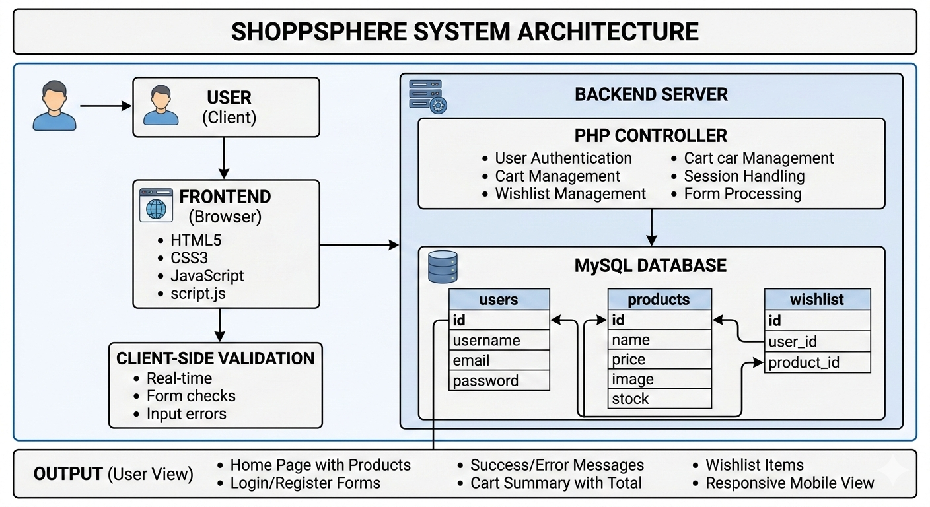
PROPOSED SYSTEM ARCHITECTURE
Input: User interactions on the e-commerce storefront. This includes clicking "Add to Cart," modifying item quantities, selecting product variants (like size or color), and the viewport dimensions of the user's specific device (mobile, tablet, or desktop).
Processing: The front-end application (e.g., built with React) intercepts these inputs. It handles the business logic by recalculating order subtotals, updating the global application state, and simultaneously adjusting the DOM to ensure the layout responds seamlessly to the current screen size.
Database: For immediate, session-proof persistence, the cart data is serialized and stored directly in the browser's client-side storage (LocalStorage). For long-term storage and cross-device synchronization, this data is later transmitted via a REST API to a backend database (such as MongoDB or PostgreSQL) when the user authenticates or begins the checkout process.
Output: A real-time, seamlessly updated user interface. The system outputs a visually optimized layout tailored to the user's device, alongside a highly reliable shopping cart that retains its contents entirely intact, even if the user refreshes the page or reopens the browser hours later.
1
2
3
4
5
6
7
8
9

Slide 7
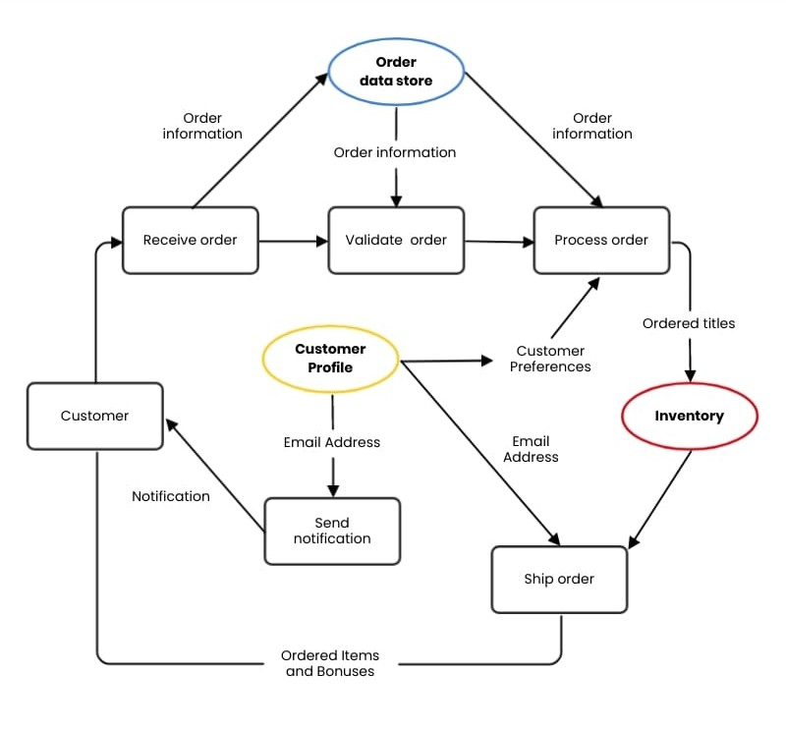
WORKFLOW
1
2
3
4
5
6
7
8
9
work flow for ecommerce cart

Slide 8
TECHNOLOGIES USED
Frontend: React.js (for building the UI), Tailwind CSS or Bootstrap (for responsiveness), and Redux or React Context API (for state management).
Backend: Node.js with Express.js (to handle API requests and business logic).
Database: MongoDB (a NoSQL database excellent for managing product catalogs and user data) and LocalStorage (for client-side cart persistence).
Tools: Visual Studio Code (IDE), Postman (API testing), and Vite or Webpack (bundler).
1
2
3
4
5
6
7
8
9

Slide 9
MODULE DESCRIPTION
Module 1: User Interface & Navigation Handles the dynamic adaptation of the layout to ensure an optimal and responsive viewing experience across all devices.
Module 2: Product Catalog Management Fetches and renders product data dynamically, allowing users to efficiently search, filter, and browse available items.
Module 3: Cart & State Persistence Manages the core cart logic and automatically synchronizes user selections with client-side storage to prevent data loss across sessions.
Module 4: Checkout & Validation Processes the persistent cart data, calculates final order totals, and prepares the accurate details for secure backend transaction processing.
1
2
3
4
5
6
7
8
9

Slide 10
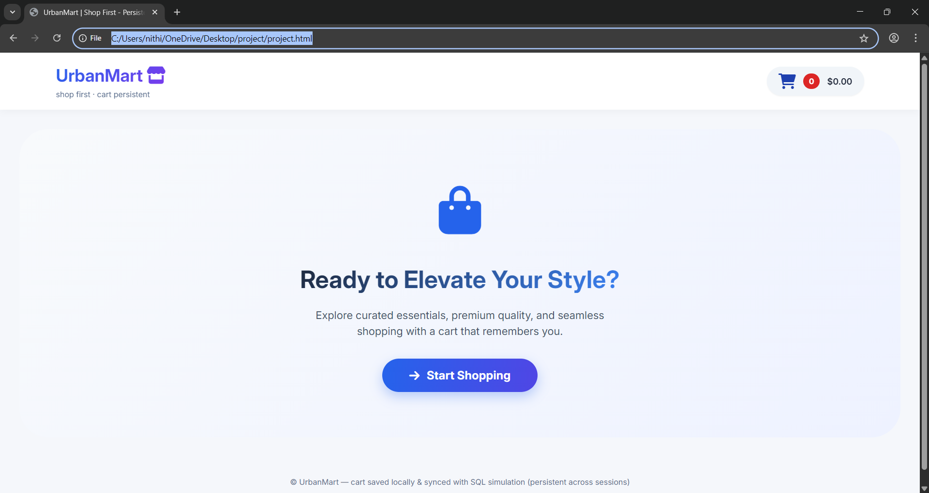
IMPLEMENTATION SCREENSHOTS
1
2
3
4
5
6
7
8
LOGIN PAGE
9
The login page provides a secure, responsive authentication gateway for users to safely access their personalized accounts. It features a clean, user-friendly form where customers enter their credentials to seamlessly retrieve their saved shopping data.

Slide 11
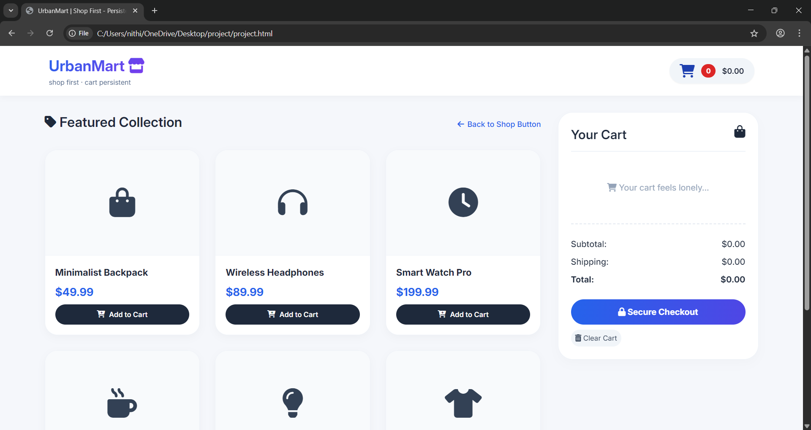
IMPLEMENTATION SCREENSHOTS
1
2
3
4
5
6
7
Home page
8(A)
9
This screenshot displays the main product catalog, allowing users to browse featured items like backpacks and smartwatches. It also highlights the integrated shopping cart sidebar, which is currently empty and ready to dynamically update as selections are made.

Slide 12
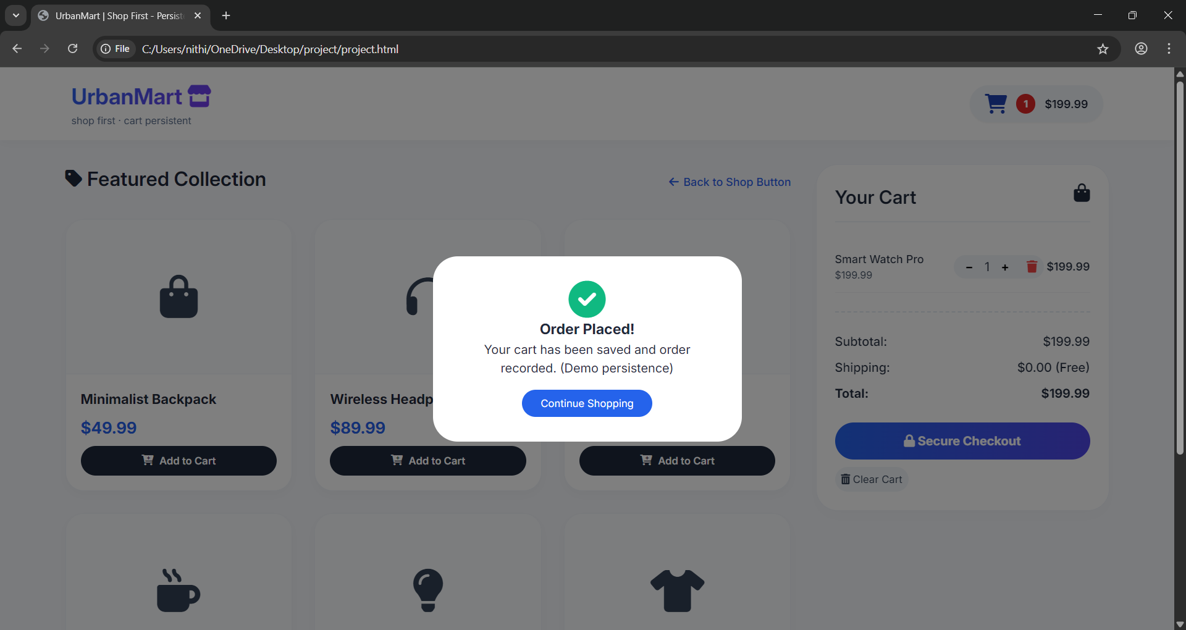
IMPLEMENTATION SCREENSHOTS
1
2
3
4
5
6
7
Order placed
8(B)
This screenshot showcases the populated shopping cart with selected items and the final subtotal ready for checkout. It highlights a central success popup confirming that the order has been successfully placed, completing the user's purchasing journey.
9

Slide 13
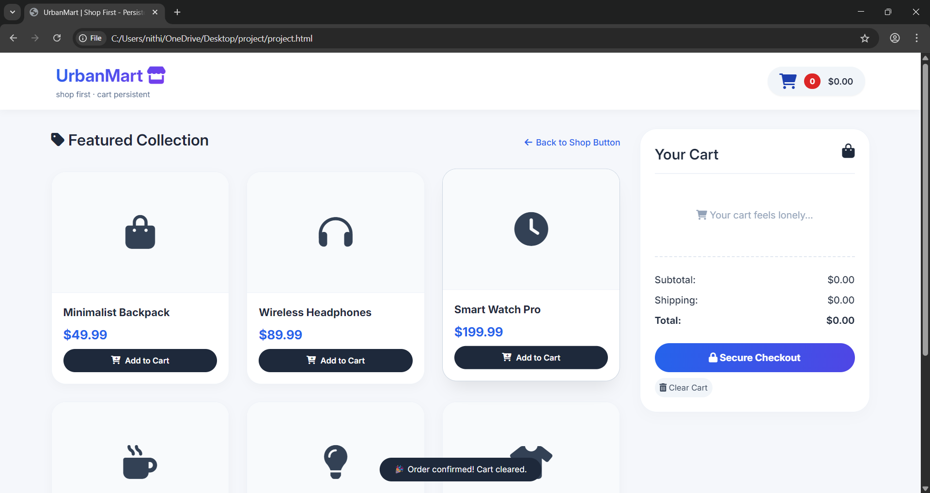
IMPLEMENTATION SCREENSHOTS
1
2
3
4
5
6
7
8(C)
order confirmation
9
This screenshot demonstrates the final order confirmation stage, featuring an "Order Placed!" success popup overlaid directly on the user's shopping cart. It visually verifies that the persistent cart data was successfully processed and the transaction is complete.

Slide 14
ADVANTAGES & LIMITATIONS
1
ADVANTAGES
Significantly reduces cart abandonment rates by securely preserving user selections across sessions and accidental page reloads.
Delivers a seamless, frictionless shopping experience that dynamically adapts to mobile, tablet, and desktop screens.
Decreases unnecessary backend server requests by efficiently managing temporary shopping data entirely on the client side.
2
3
4
5
6
7
LIMITATIONS
Client-side storage is device-specific, meaning a cart started on a mobile phone will not automatically sync to a desktop without user authentication.
If a customer explicitly clears their browser cache or local website data, their un-saved shopping cart contents will be lost.
Relying heavily on front-end local storage can expose temporary data to potential cross-site scripting (XSS) vulnerabilities if inputs are not properly sanitized.
8
9

Slide 15
Thank you

